Slide 1
Employee Data Analysis using Excel
STUDENT NAME: KEERTHANA.V
REGISTER NO: 122202174 ( asunm1353122202174 )
DEPARTMENT: B.COM CORPORATE SECRETARYSHIP
COLLEGE: ANNA ADARSH COLLEGE FOR WOMEN

Slide 2
PROJECT TITLE
Employee Performance Analysis using Excel

Slide 3


AGENDA
Problem Statement
Project Overview
End Users
Our Solution and Proposition
Dataset Description
Modelling Approach
Results and Discussion
Conclusion
3/21/2024 Annual Review

Slide 4

PROBLEM STATEMENT
This project aims to analyse employee performance data using Excel to gain insights into individual and team productivity, identify key performance trends, and highlight areas for improvement. By leveraging Excel's analytical tools, the project will provide a comprehensive and data-driven evaluation of employee performance, enabling better decision-making for talent management and organizational growth.

Slide 5

PROJECT OVERVIEW
Employee performance analysis is a critical process for understanding and improving workforce productivity and efficiency. Using Excel as a tool for this analysis provides a cost-effective and versatile approach to managing and evaluating employee performance data. This project focuses on utilizing Excel's data management, analytical, and visualization capabilities to assess employee performance metrics, identify trends, and support data-driven decision-making. By doing so, organizations can better understand their employees' strengths and areas for improvement, leading to more effective talent management and enhanced overall performance.

Slide 6


WHO ARE THE END USERS?
HR Managers and Personnel: They can use the analysis to make informed decisions about employee development, training needs, and performance appraisals.
Department Heads and Team Leaders: These users can utilize the insights to manage their teams effectively, identify high performers, and provide targeted support where needed.

Slide 7

Senior Management and Executives: They can leverage the data to align employee performance with strategic business goals, make high-level staffing decisions, and drive organizational growth.
Employees: Individual employees can use the feedback from the performance analysis to understand their strengths and areas for improvement, aiding in their professional development.

Slide 8

OUR SOLUTION AND ITS VALUE PROPOSITION
DATA CLEANING
Conditional Formating – Missing Values
Filter – Remove Missing Values
Formula – To Calculate Performance Category
Pivot – Summary
Graph – Data Visualization

Slide 9
Dataset Description
DATA COLLECTION
EMPLOYEE – KAGGLE
There are 26 Features but here I considered only 6 Features, there are as follow:
Employee ID – In Numerical Value
Name – In Text
Employee Type
Performance Level
Gender – Male/Female
Employee Rating – In Numericals

Slide 10

THE "WOW" IN OUR SOLUTION
PERFORMANCE LEVEL
IFS(Z8>=5,”VERY HIGH”,Z8>=4,”HIGH”,Z8>=3,”MED”,TRUE,”LOW”)
New idea concept in Formula’s presented in this excel project.
3/21/2024 Annual Review
10

Slide 11
MODELLING
DATA COLLECTION
FEATURE COLLECTION
DATA CLEANING
PERFORMANCE LEVEL
SUMMARY – PIVOT TABLE
GRAPH – DATA VISUALIZATION
11

Slide 12
DATA COLLECTION
Excel sheets were taken from the Kaggle ( Employee data set sheets), where 26 features are available but I considered only 9 of them. There as follow:
Employee Id – In Numerical
Name – In Text
Employee Type
Performance Level
Gender – Male/Female
Employee Rating – In Numerical

Slide 13
DATA CLEANING
Condition formating – Missing Values
Filter – Missing values ( REMOVE)
Formula – To calculate Performance category
Pivot – Summary
Graph – Data Visualization
PERFORMANCE LEVEL
New idea concept in formula’s
IFS(Z8>=5,”VERY HIGH”,Z8>=4,”HIGH”,Z8>=3,”MED”,TRUE,”LOW”)

Slide 14
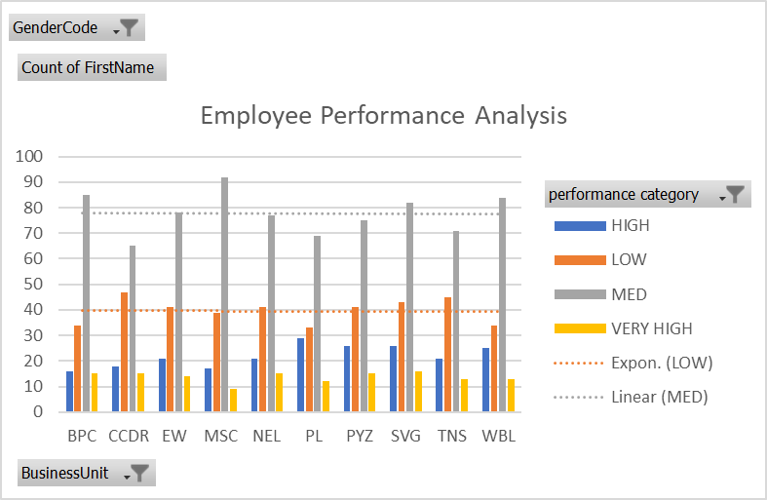
GRAPH – DATA VISUALIZATION

Slide 15
RESULTS
GRAPH ( DATA VISUALIZATION )
15

Slide 16
conclusion
The employee performance analysis using Excel effectively identified key performance metrics, highlighted areas of strength, and pinpointed opportunities for improvement. By leveraging Excel's data analysis and visualization capabilities, the project provided clear, actionable insights to enhance individual and team performance, facilitating data-driven decision-making for future training, development, and resource allocation.

